Slide 1
EZ-Cart Design Review
Daniel Ryaboshapka, Moises Abbo, Stephanie Bentley, Rebecca Shen, Taylor Korte
Notes:
Problem Definition, Goals, and Table of Contents
Videos, Bullets, 1 on 1 Feedback
Overall Feedback
Chris Feedback:
-Likes vending machine combined with shelf robot, implement gravity assisted shelves with forklift
-Limit to one product (e.g. spices or tomato sauce)

Slide 2
Problem Definition & Presentation Overview
How can we reduce the difficulty of stocking & picking grocery items in an aisle?
Individual Design Pitches and Feedback
Overall Design Review and Questions
Notes:
Our goal for this meeting is for us to present our 5 potential solutions for this problem, and for each we hope for you to provide us individualized feedback per design, as well as any questions you might have. After all designs are presented, we hope to do an overall design review and feedback session, where you can ask more general questions or any other individual questions that may arise.

Slide 3
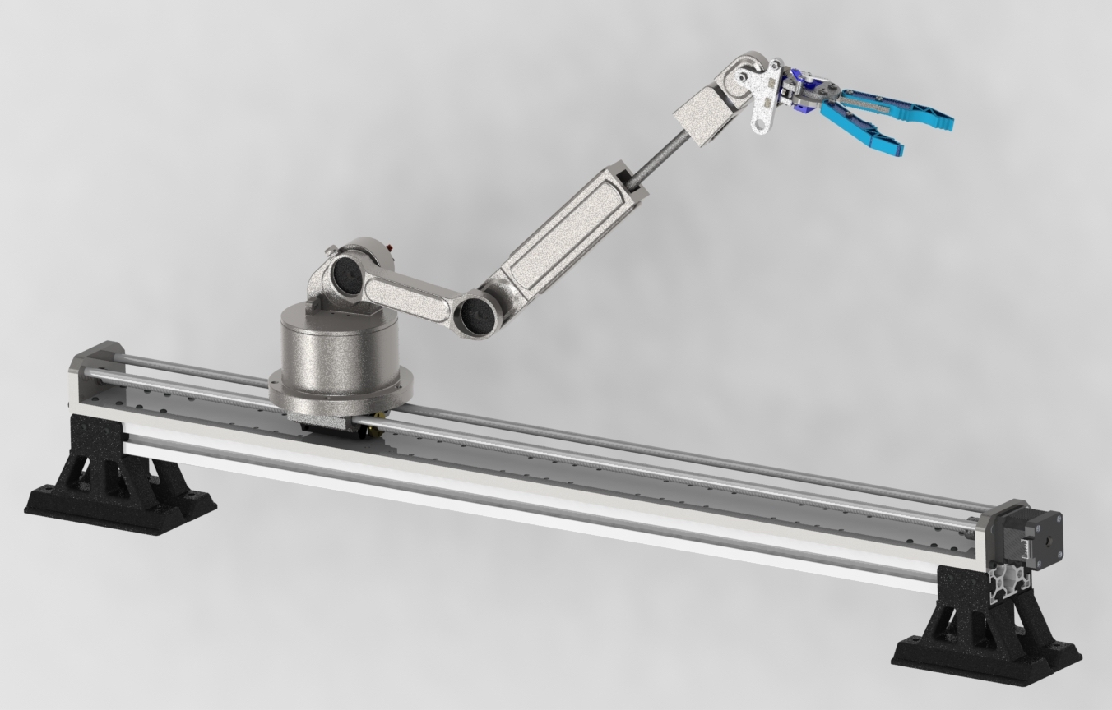

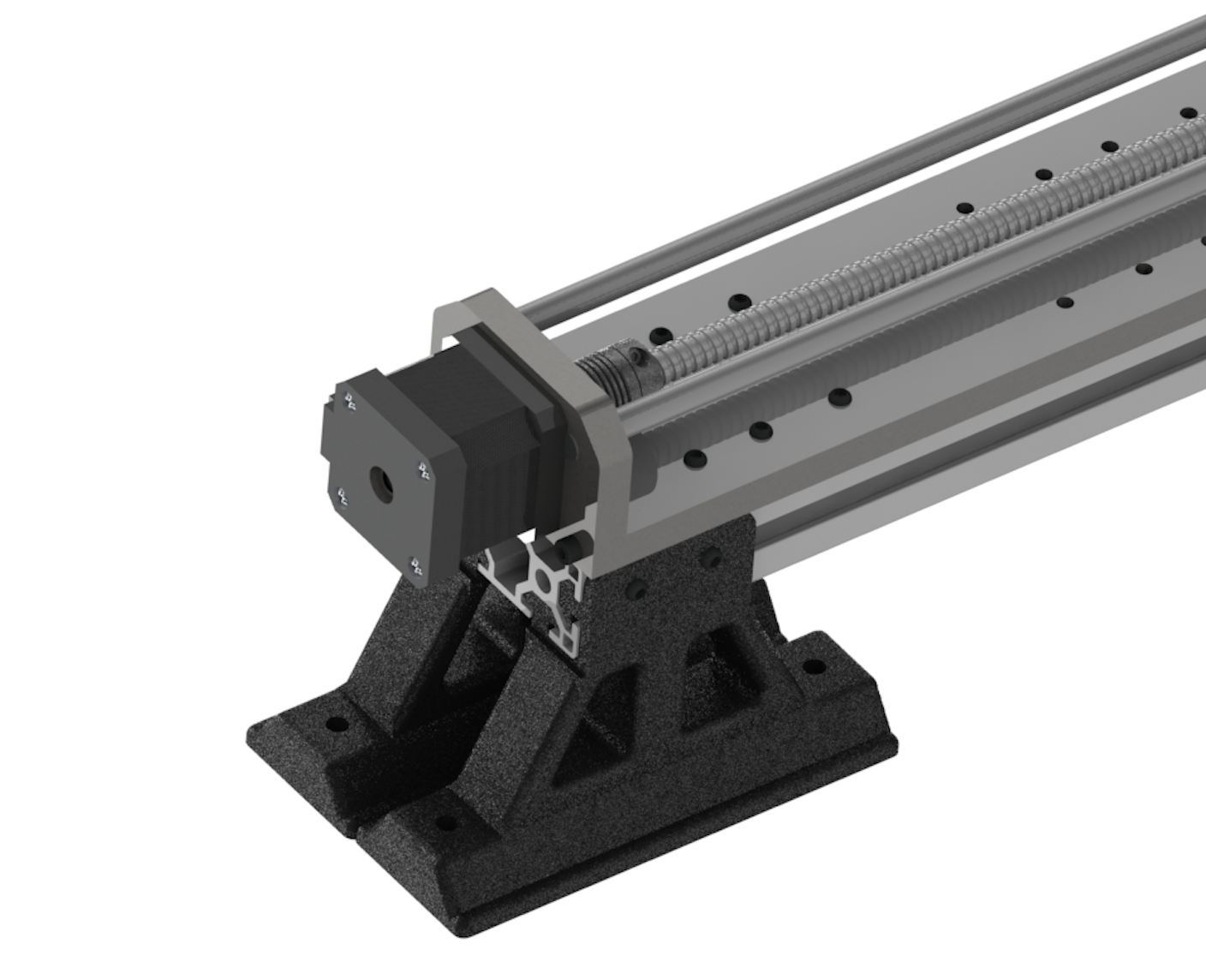
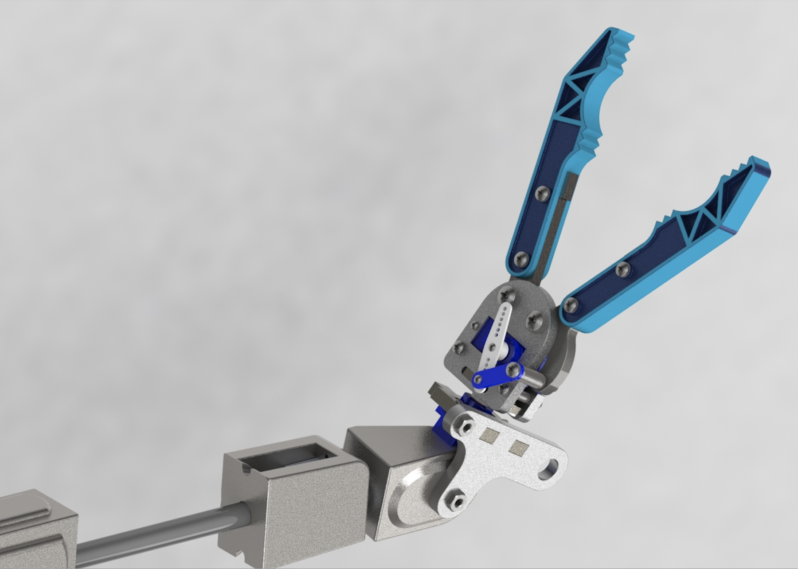
Concept 1: Attachable Arm
Full Assembly
Ball Screw
Rail System
End Effector w/ Linear Actuator
Notes:
The attachable arm is designed to be mounted on the sides, bottom, or top of a grocery aisle depending on the store design. It utilizes a ball screw linear actuator rail system and the robotic arm is mounted onto a carriage that allows for translation up and down or side to side on a shelf. The arm itself has 5 DoF, 4 revolute joints and 1 prismatic joint that increases the arm length in order to maximize reach. The consumer will be able to enter into a user interface the product they want, and the arm will navigate the shelf and bring it to the consumer.
This design can be expanded to include a longer rail, it can be easily implemented into different aisles, and the end effector can be switched out.
https://chime.aws/7547366260

Slide 4
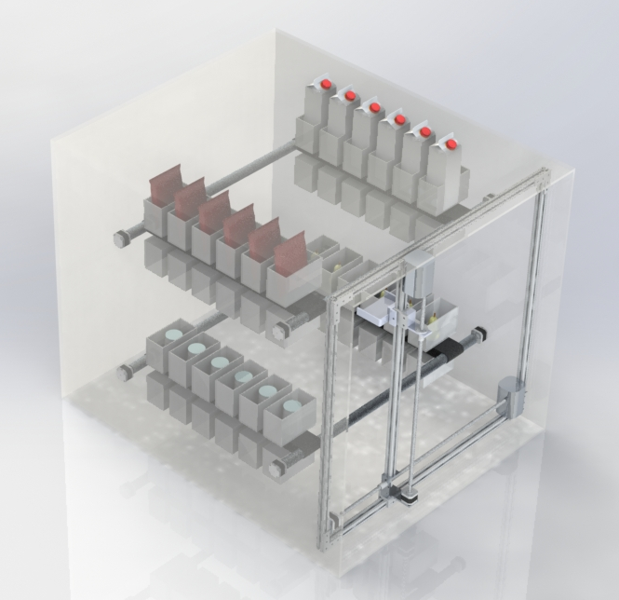
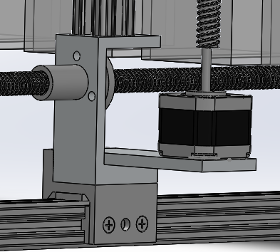
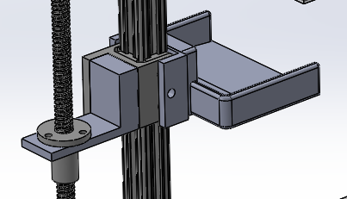
Concept 2: Vending Machine
XZ Plotter:
End-Effector:
Notes:
This design uses an xz plotter in order to move the end-effector to the desired shelf. The shelves contain rollers with attached belts in order to form a conveyor-belt-like system. These belts have bins attached containing different foods. When the end-effector is in place below the belt the motor rotates the belt in order to tip the bin closes to the front and dispense the food onto the arm. The product is then lowered to the bottom of the machine to the customer. This design can be expanded to fit bigger items but would need to have a refrigeration system implemented in order to store dairy products. This machine can also function inside or outside of the store.

Slide 5



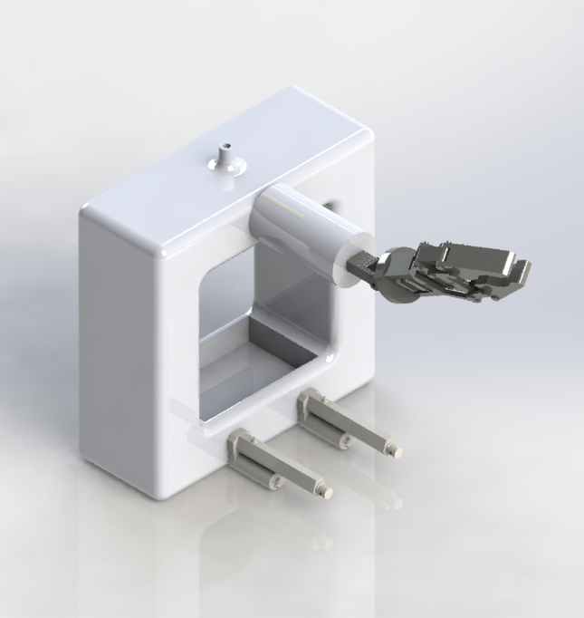
Concept 3: Wire System
UI System:
Main Robot:

Slide 6
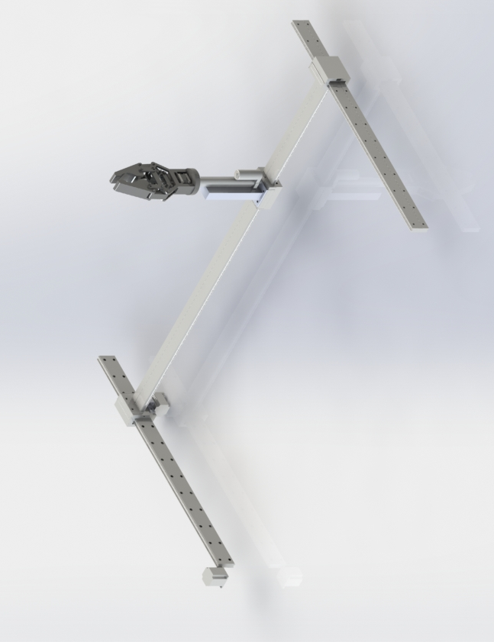
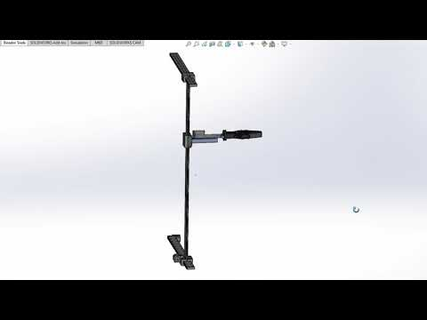
Concept 4: XY Plotter
Belt-Driven Carriage/Rail System for XZ Translation
Modular End-Effector Design
Linear Actuator for Extension
Notes:
For this concept we have another XY/XZ plotter system utilizing belt-driven actuators. Two horizontal rails seen in the first image will be attached to a shelf on the aisle, with carriages driven by the belts to perform lateral and vertical movement. For the end-effector, we are using a modular design in order to test the best gripper that can pick up a wide range of grocery items, along with a linear actuator that can allow extension into the shelf.

Slide 7
Concept 5: Free-Standing
Based on human capabilities
Store layout
High degree of freedom in reaching places
8x8 traction
Needs space to operate
Grabs one item at a time
Notes:
What the robot does fr the user
Concept 5 is a free standing robot that can go around on any grocery store.
In comparison to the other concepts, this one doenst need you to change anything in the grocery store
It has one main arm that can rotate 360, up and down, and extend itself to achieve further distances.
Tha grapper at the end of the arm was design based of a human hand capabilities, so it will be able to do normal stuf like opening a door for example.
It has a space to put a basket with all the products collected.

